Slide 1
The SODI project and topical legal questions arising from financial fraud against consumers
PhD candidate Vebjørn Wold and Prof. Marte Eidsand Kjørven

Slide 2
Societal Security and Digital Identities (SODI)
study how law and technology can work together to detect and reduce vulnerabilities linked to the use and misuse of eID systems
Addressing two key issues
Identity theft and fraud
Digital exclusion/access to eID for all

Slide 3
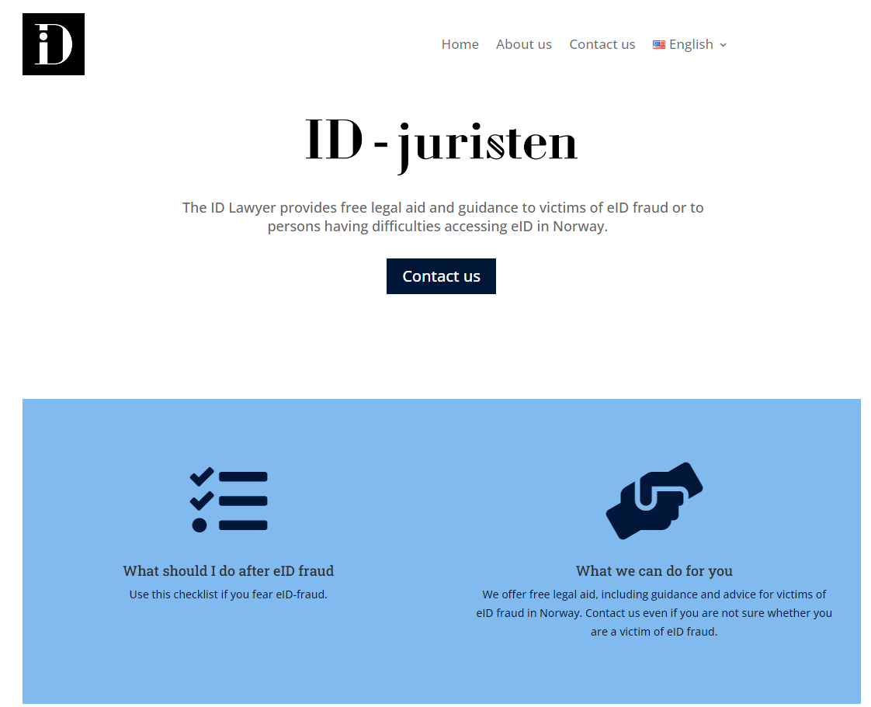

Slide 4
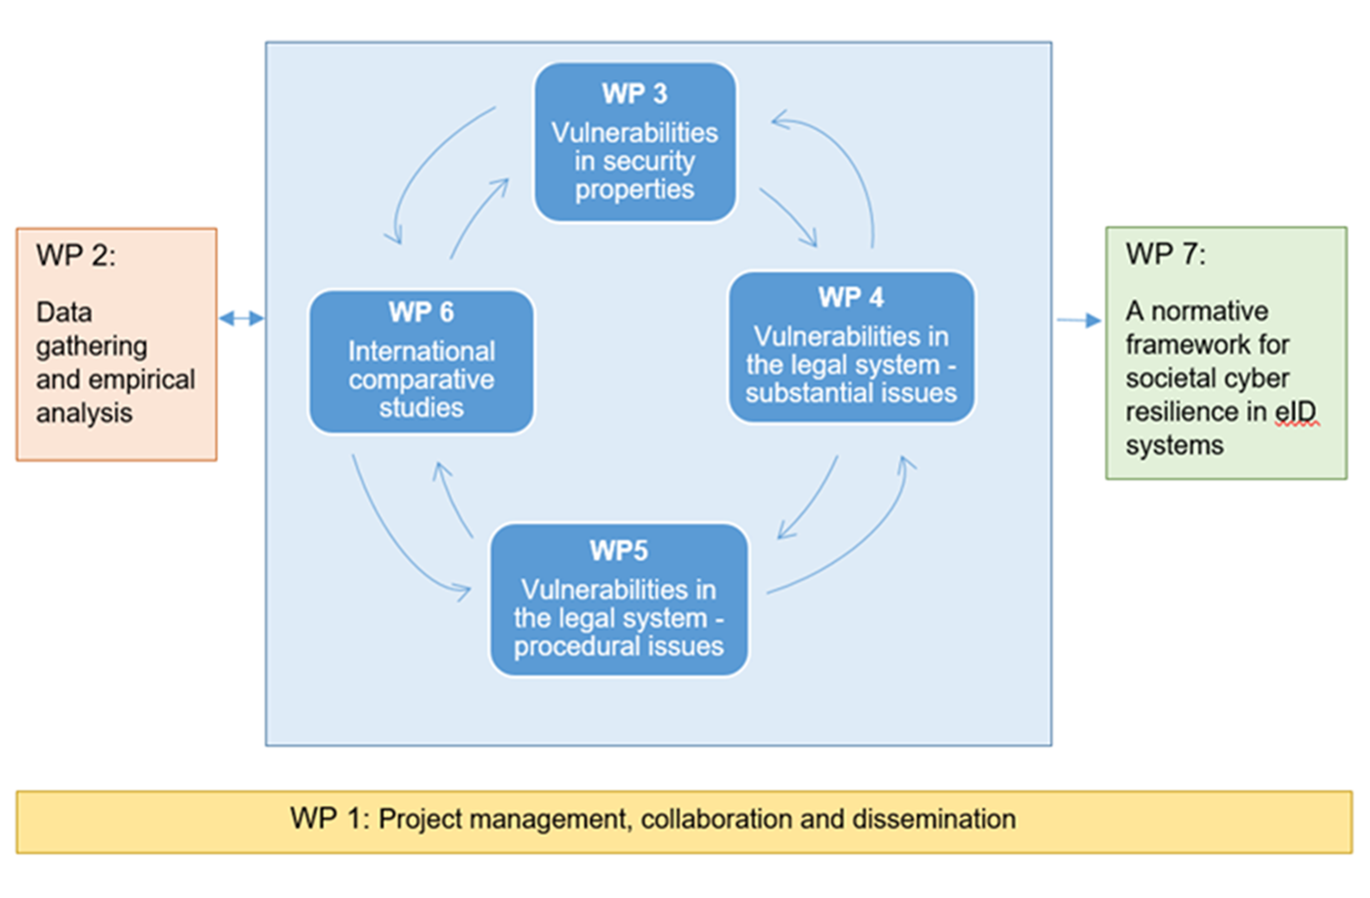
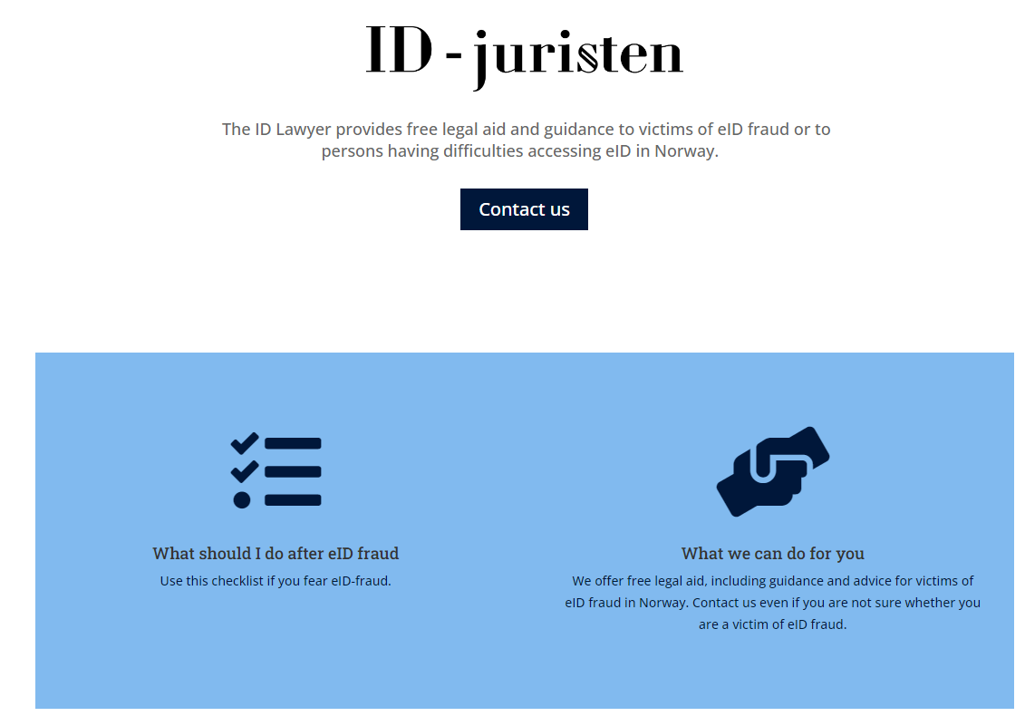

Slide 5
‘Consenting to scams’
The present and future of payment fraud regulation in Europe

Slide 6
A dispatch from Sweden

Slide 7
A dispatch from Sweden
“We have to be very clear that there are still honest people using cash,” Riksbank Governor Erik Thedeen told Bloomberg…
That has been a strategic mistake,” Larson said. “This profit-generating crime is what’s fueling organized crime and, in some cases, leads to these conflicts.”

Slide 8
The dangers of ‘master keys’
‘Multi-purpose authentication means, as exemplified by the currently developed EUDI-Wallet, confront a different form of exposure not encountered by authentication means dedicated to a specific purpose (e.g. an online banking service from a specific PSP).’
“’It ends up not really being a security measure, but just another step in using a website,” she said. “You don’t really think twice about what the BankID app might say you are logging into.’”

Slide 9
Social costs rather then a matter of financial stability?
Fraud rate on payments in Italy (Cologgi, 2023)

Slide 10
The regulatory framework
General requirements for sound operations and risk management (PSD II art 95 (1)
Strong customer authentication
‘Dynamic linking’ as per PSD II article 97 (2)
Monitoring mechanisms, as per Delegated Regulation (EU) 2018/389
AML-based monitoring requirements
Clearing systems, instant payments systems
The scheme for loss allocation in articles 73 and 74

Slide 11
Payment fraud regulation as regulatory private law
PSD II (preamble):
“compel them to take responsibility for the respective parts of the transaction that are under their control…
an incentive for the payment service user to notify…
…harmonised and high-level user protection within the Union
EBA:
“incentives to invest in effective transaction monitoring mechanisms “

Slide 12
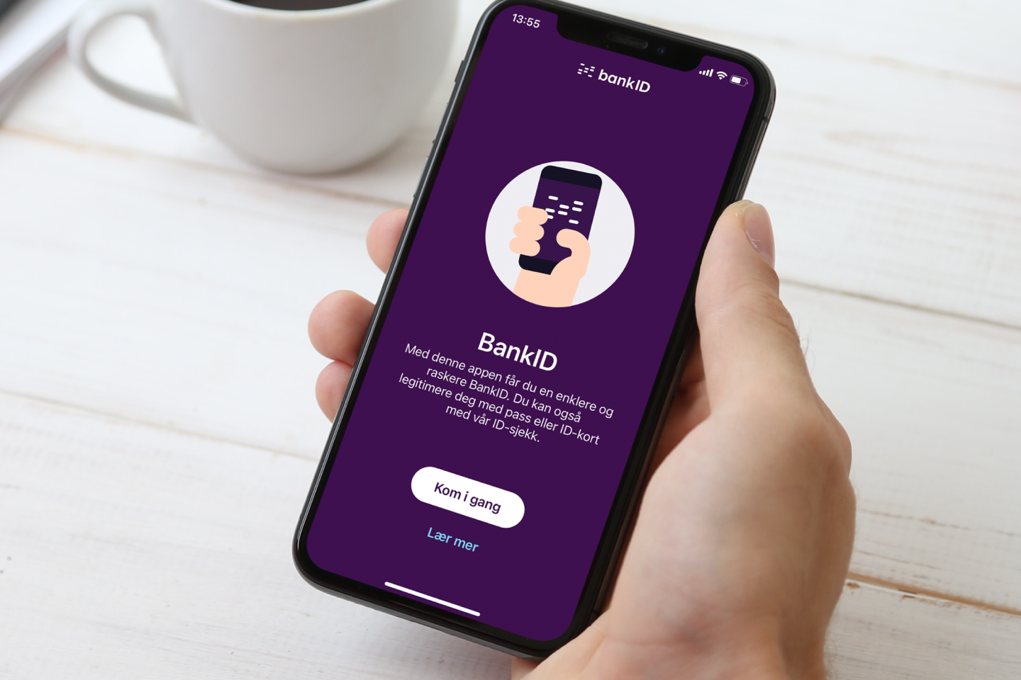
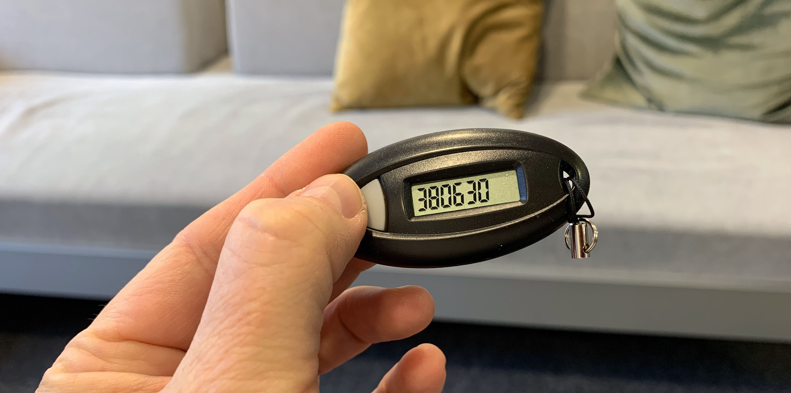
Strong customer authentication methods

Slide 13
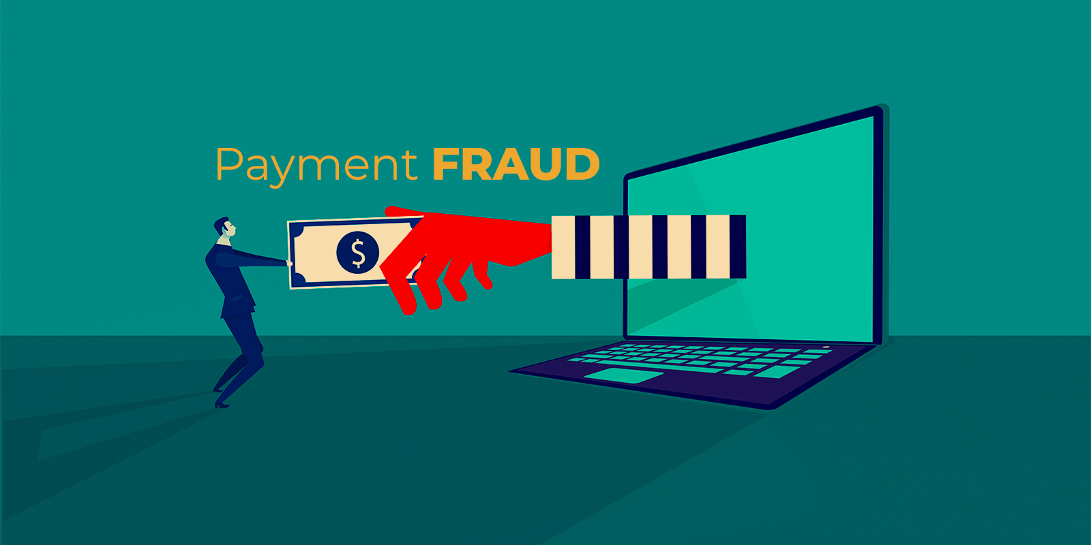
'Traditional' modes of payment fraud
The bank bears the loss, unless the consumer is grossly negligent
'Phishing'
'Vishing'
Card fraud
The customer does not 'consent' to the payment as per PSD II article 64 (1)
Discussions regarding apparent authority, underlying contract terms etc.
The bank bears the loss unless the consumer has shown 'gross negligence' as per PSD II 73 and 74.
Application of the standard of negligence left to the member states

Slide 14
'Traditional' modes of payment fraud
«…if the bank has no right to be reimbursed by the customer for the payment it has made e.g. because it acted without a mandate, the payment is at the expense of the bank alone» (Goff & Jones, 2022 p 172)

Slide 15
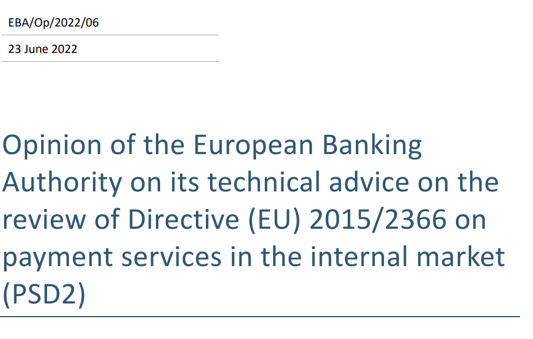
The turn to social manipulation schemes

Slide 16
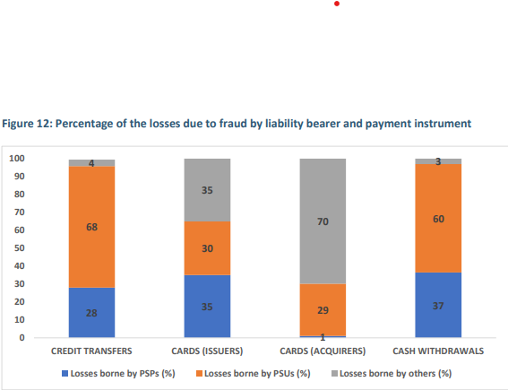
EBA/DP/2022/01
The turn to social manipulation schemes

Slide 17
Social manipulation fraud
Exploiting mobile-based authentication solutions
Speaking on the phone with the consumer, tricking him into approving login and payment under false pretenses
'Safe account'
The consumer must transfer to money to a 'safe account' opened in their name
Romance scams, investment scams
CEO fraud

Slide 18
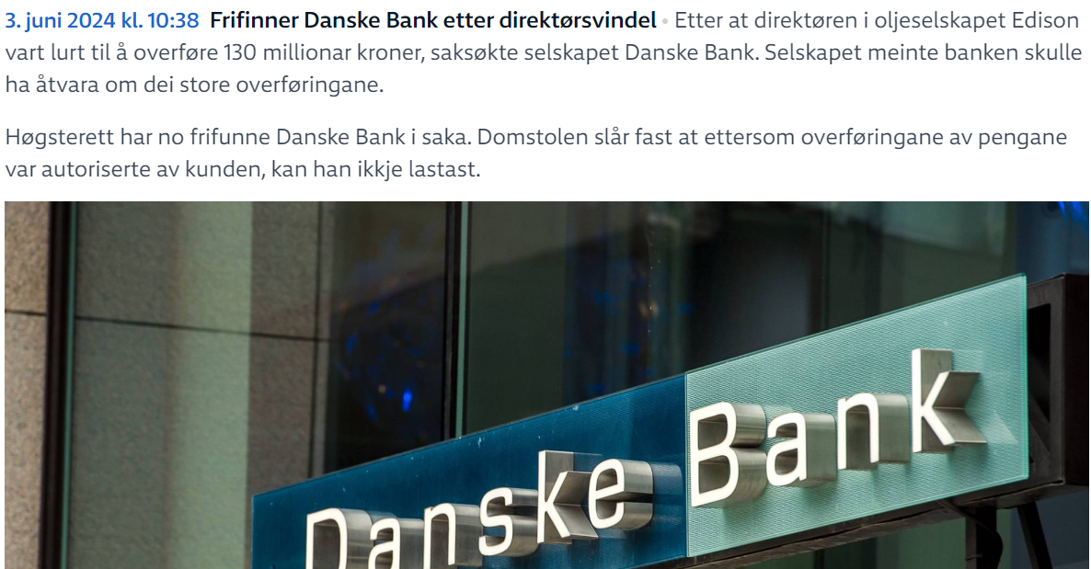
Social manipulation fraud
A recent Norwegian-Italian CEO-fraud case – losses of more than 10 million euros

Slide 19
Views on interpretation of the current directive
Commission: “[PSD2] ….does not cover the types of fraud which have emerged since its adoption and which have become increasingly widespread, such as cases where consumers are manipulated by fraudsters and tricked into authorising a payment transaction.
…with social engineering, the difference between authorised and non-authorised transactions is becoming more blurred and complex to apply in practice”

Slide 20
Views on interpretation of the current directive
Reich, Casper (2023) „Zentrale Frage in dieser Betrugskonstellation ist, ob der Zahlungsdienstnutzer die Autorisierung mit Erklärungsbewusstsein erklärt hat.“
Norwegian ADR cases – subjective approach, only of the consumer understands that
Romance scams, investment scams still authorised, quasi-authorised scams and safe-account scams unauthorised
Swedish ADR cases – objective approach, if the act of authentication is preformed voulntarily

Slide 21
PSR proposal - background
EBA:
“Little incentives to invest in effective transaction monitoring mechanisms that could mitigate the social engineering risks…”
“harmonised and high-level user protection within the Union by covering payment transactions that have been authorized by the payer under manipulation of the fraudster within the scope of unauthorized payment transactions”

Slide 23
Commission (2023)
The banks:
«There needs to be more accountability on the user side in the online world…»
The authors of the study:
«Banking representatives claim that the burden of fraud disproportionately falls on them, but this is not corroborated by facts»
The UK model: a regulatory scheme covering all fraudulent transactions

Slide 24
The proposal for a new regulation
Commission
Parliament
It is therefore no longer possible, as was the case in Directive (EU) 2015/2366, to limit refunds to unauthorised transactions only. It would however be disproportionate and financially very costly to payment services providers to open every fraudulent transaction, authorised or unauthorised, to a systematic refund right. It might also cause moral hazard and a reduction in the customer’s vigilance.
It is therefore no longer possible, as was the case in Directive (EU) 2015/2366, to limit refunds to unauthorised transactions only. ▐

Slide 25
“With regard to the authorisation of payment transactions, permission should express the intention of the payer on the basis of full knowledge of relevant facts including the amount, recipient and purpose of the transaction.
The intention of the payer, based on the full knowledge of relevant facts, at the time of transaction, should be assessed pursuant to national law“ (preamble (79a))

Slide 26
A wide impersenation rule
Commission
Parliament
Artikkel 59
“Where a payment services user who is a consumer was manipulated by a third party pretending to be an employee of the consumer’s payment service provider…”
Artikkel 59
“Where a payment services user who is a consumer was manipulated by a third party pretending to be an employee of the consumer’s payment service provider
or any other relevant entity of a public or private nature..“

Slide 27
Tackling the ecosystem
PSR proposal article 59 (5)
“All providers involved in the fraud chain shall act swiftly to ensure that the appropriate organisational and technical measures are in place to safeguard the security of payments users when making transactions. Payment service providers, electronic communications service providers and digital platform service providers shall have in place fraud prevention and mitigation techniques to fight fraud in all its configurations, including non-authorised and authorised push payment fraud.”

Slide 28
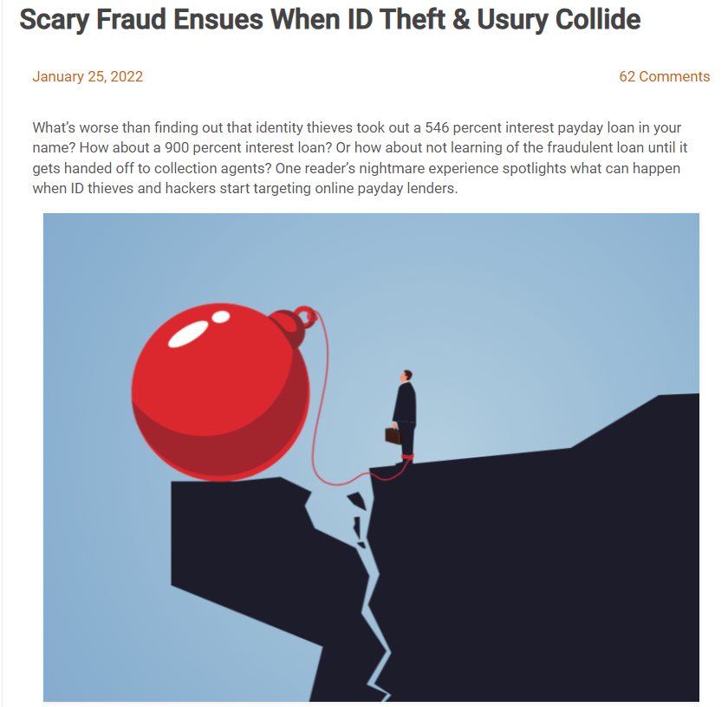

Slide 29
Unauthorised credit fraud in Norway
Before 2020
Consumers where held liable for credit contracts concluded by others because they
Where unable to prove the fraud, or
Were seen to have acted negligently by courts
Late 2020
A supreme court case (HR-2020-2021-A) the focus from security mistakes on part of the consumer to the responsibilities of the banks
Norwegian legislators extended consumer protection principles under PSD2 to other financial transactions, including credit

